Slide 1


HỌC VIỆN CÔNG NGHỆ BƯU CHÍNH VIỄN THÔNG
COMPUTER ARCHITECTURE
CACHE & MEMORY
Instructor: Associate Professor Phạm Văn Cường
E-mail: cuongpham.ptit@gmail.com
www: https://sites.google.com/view/cuongpham/home

Slide 2
Agenda
Introduction to hierarchical memory
Memory classification
- ROM
- RAM
Cache Memory

Slide 3
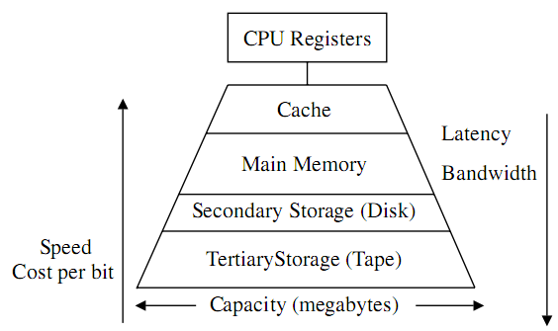
Hierarchical model

Slide 4
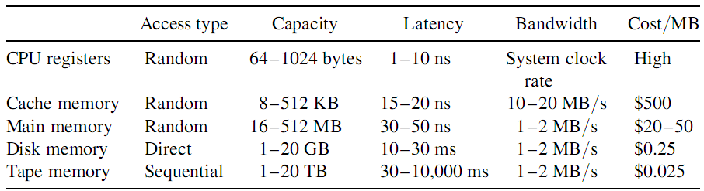
Figures

Slide 5
Memory system
CPU registers:
Small size, few bytes to few KB
High speed access (0,25ns)
Expensive
Cache memory:
Small capacity (8KB to 32MB)
High speed access (1-5ns)
Expensive
So called smart memory
Store opcode and data to be processed by CPU.

Slide 6
Memory system
Main memory:
ROM and RAM, large size, about 256MB to 16GB
Low-speed access (50 to 70ns)
Cheap
Store opcode and data of systems and users.
Secondary memory:
Very large capacity, from few GB to few TB
Very slow speed access (5ms)
Very cheap
Store data (files).

Slide 7
Why hierarchical memory ?
Performance improvement
Balancing between high-speed processing of CPU and low-speed processing of main memory and secondary memory;
Cost reduction
Expensive memories such as registers and cache can be used with a small amount;
Cheap memories such as main memory and secondary memory are used with large amount;
➔ Sum of costs will be reduced.

Slide 8
Memory classification
Access types:
Random Access Memory (RAM)
Serial Access Memory (SAM)
Read Only Memory (ROM)
Volatile types:
Volatile memory (RAM): data are removed if the power supply is off.
Non-volatile memory (ROM, HDD)
Manufacture technology:
Semiconductor memory: ROM, RAM
Magnetic memory: HDD, FDD, tape
Optical memory: CD, DVD

Slide 9
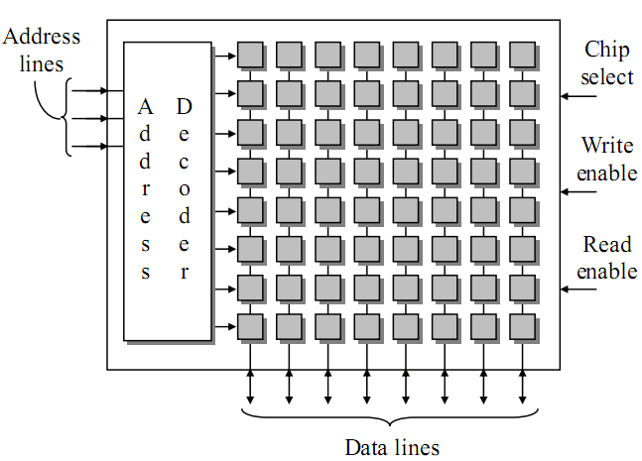
Memory circuit organization

Slide 10
ROM
Read Only Memory
Data are written in ROM using specialized technology;
ROM is a stable memory
Information stored in ROM is not losing even power supply is off
ROM is a semi-conductor memory; each cell is a semi-conductor gate
ROM is usually stored system information:
BIOS (Basic Input Output System).

Slide 11
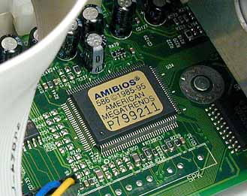
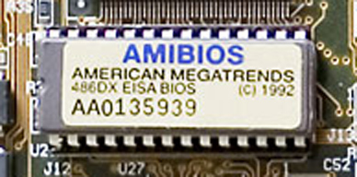
ROM example

Slide 12
RAM
RAM (Random Access Memory)
Each cell in RAM can randomly be accessed;
Access speed for all memory cells are equal.
RAM is not a stable:
Information stored in RAM is removed when power supply is off
RAM is a semi-conductor memory
RAM stores information of systems and users
Notes:
f

Slide 13
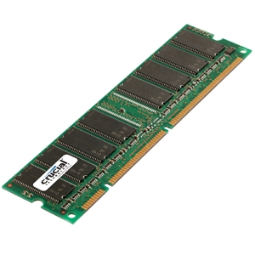
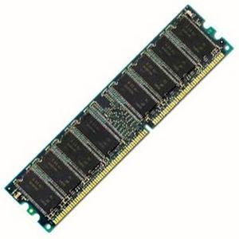
RAM examples
SDRAM PC133
DDR3 1066 SDRAM

Slide 14
Cache memory
What is Cache?
Cache principles
Hit rate and miss rate
Cache architecture
Cache organization
Read/Write
Replication policies

Slide 15
What is a Cache?
Cache is a smart memory:
Cache is in between main memory and CPU;
Cache:
is positioned out of CPU (old systems)
Is integrated inside CPU.
CPU
Cache
Main memory

Slide 16
Cache
Performance improvement
Balanced between high-speed CPU and low-speed main memory;
Reducing time for access data and instructions.
Cost reduction
Two computer systems have the same cost, the one with cache has higher speed access than the other;

Slide 17
Principles
Cache is call a smart memory:
Cache is able to predict data and instructions need to be executed by CPU;
Access data in cache is fast.
Two principles:
Spatial locality
Temporal locality

Slide 18
Examples
Spatial locality
If a memory cell is accessed, its neighbors can be highly likely accessed;
Array, linked list etc.
Access by blocks
Neighbour cell
Current cell
Neighbour cell

Slide 19
Example
Temporal locality
If a memory cell has been accessed, it would be highly likely accessed again;
Loop, branch
Start of loop
Instruction 1
Instruction 2
Instruction 3
Instruction 4
End of loop
Instruction 5

Slide 20
4.5.4 Data exchange among CPU-Cache-Mem
CPU read/write individual data items from/to cache
Cache read/write data blocks (multiple words) from/to main memory
why?
CPU
Cache
Memory
Individual data items: byte, word
Block of data: 16, 32, 64 bytes
Notes:
D08CN5 4.3, D08CN4 9.3

Slide 21
hit and miss
Hit: CPU accesses a data item that is available in cache:
Probability of a hit called hit rate (standed for H).
0 <= H <= 1
The bigger hit rate, the higher performance of the cache.
Miss CPU accesses a data item that is unavailable in cache:
Probability of a miss called miss rate, 1-H.
0 <= (1 – H) <= 1
The lower miss rate, the less performance of the cache.
Notes:
D08CN6 4.3

Slide 22
Cache architecture – Look aside
Cache and main memory share the system buses;
Advantages:
Simple design
Quick Miss
Disadvantages:
Slow hit
CPU
SRAM
System bus
Cache controller
Tag RAM
Main Memory

Slide 23
Cache’s architecture – Look through
Cache is in between CPU and main memory;
Advantages:
Fast Hit
Disadvantages:
Complex design
Expensive
Slow Miss
CPU
SRAM
Cache controller
Tag RAM
Main Memory

Slide 24
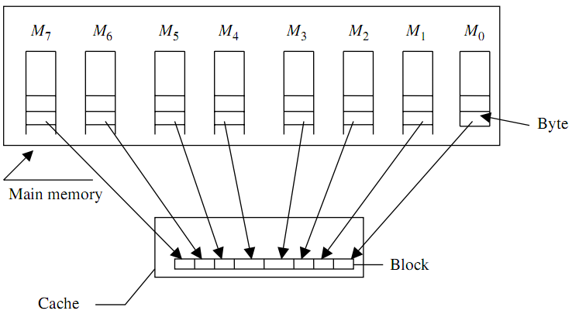
Cache organization
How cache and main memory can communicate?

Slide 25
Cache organization
Direct mapping
Fast and simple
“Hard” mapping, more conflicted
Fully associative mapping
Slow and complex
“Soft” mapping, less conflicted
Set associative mapping
Fast and complex
“Soft” mapping, less conflicted

Slide 26
Direct mapping
Page m-1
Page 1
Page 0
Line n-1
Line n-1
Line 1
Line 1
Line 0
Line 0
Memory
Cache

Slide 27
Direct mapping
Cache:
Partitioned into n blocks or lines Line₀ to Line_{n-1}
Memory:
Partitioned into m pages, page₀ to page_{m-1}.
Each page sizes equally to cache (each page has n lines)
Mapping:
Line₀ of {page₀ …page_{m-1}} is mapped to cache’s line₀
Line₁ of {page₀ …page_{m-1} } is mapped to cache’s line₁;
....
Line_{n-1} of {page₀ …page_{m-1}} is mapped to cache’s Line_{n-1};

Slide 28
Direct mapping
Advantages:
Simple design
Fast.
Disadvantages:
Highly conflicted
Low hit rate.

Slide 29
Fully associative mapping
Line m-1
Line n-1
Line 1
Line 0
Cache
Line 1
Line 0
Memory

Slide 30
Fully associative mapping
Cache:
Partitioned into n lines Line₀ to Line_{n-1}
Memory:
Partitioned into m lines Line₀ to Line_{m-1}.
Sizes of cache’s lines and memory’s lines are equal
m is much greater than n (m >> n).
Mapping:
Each line in memory can be mapped into any line in cache;

Slide 31
Fully associative mapping
Advantages:
Reduce conflicts
Hit rate is higher than direct mapping.
Disadvantages:
Slow due to time taken for finding data in cache
Complex due to address decoding.
Only suitable for small caches.

Slide 32
Set associative mapping
Page m-1
Page 1
Way 0
Way 1
Page 0
Line n-1
Line n-1
Line n-1
Line 1
Line 1
Line 1
Line 0
Line 0
Line 0
Bộ nhớ
Cache

Slide 33
Set associative mapping
Cache:
Partitioned into k way (same sizes);
Each way has n lines, Line₀ to Line_{n-1}
Memory:
Partitioned into m pages, page₀ to page_{m-1}.
Page size equals to cache’s way size
Each page has n lines, Line₀ to Line_{n-1}
Mapping:
Page is mapped to any way (flexible):
Each page can be mapped onto any way in cache.
Mapping from fine in memory to line in way is fixed:
Line_{k} of page_{i} is mapped into Line_{k} of way_{j};

Slide 34
Set associative mapping
Advantages:
Fast (as direct mapping);
Reduce conflicts.
High hit rate.
Disadvantages:
Complex (design and control).

Slide 35
Cache’s lines replacement
Why?
Mapping between memory to cache is many-to-one;
Many lines in memory share one line in cache.
Replacement is to determind which line in cache is replaced with lines from memory.
Replacement policies :
Random
First in first out (FIFO)
Least Recently Used (LRU).

Slide 36
Cache performance
Access time (t_{access}) of a cache-memory system:
t_{access} = (Hit cost) + (miss rate) * (miss penalty)
t_{access} = t_{cache} + (1 - H) * (t_{memory})
H is the hit-rate, t_{cache} is cache access time, t_{memory} is memory access time.
If t_{cache} = 5ns, t_{memory} = 60ns và H=80%, then:
t_{access} = 5 + (1 – 0.8) * (60) = 5+12 = 17ns
If t_{cache} = 5ns, t_{memory} = 60ns và H=95%, then:
t_{access} = 5 + (1 – 0.95) * (60) = 5+3 = 8ns

